Slide 1

An Online WebchatApplication

Slide 2
SUBMITTED BY:
JAIDEEP LALCHANDANI (181500290)
MANSI GOYAL (181500370)
NIDHI GUPTA (181500422)
PRASHANT TOMAR (181500492)
RADHIKA SINGH (181500529)

Slide 3
Idea of Creation
The webchat is been developed for web-technologies on various devices like iPad, mobile phones, desktop, laptops, etc. by many users. Multiple users can interact at the same time on this web-page and can chit-chat there.
Front-end is a practice of converting data to a graphical interface, through the use of HTML, CSS, and JavaScript, so the users can view and interact with that data.
Back-end development refers to server-side development. It focuses on databases, scripting, and architecture of website & the code helps to communicate the database information to the browser displaying the front-end.

Slide 4
Motivation
In today’s era, we all are aware of the need to communicate with each other.
However we the people are so busy in our own lives, we forget and sometimes ignore that the world beyond us exists.
One solution to this problem can be the Virtual Communication and is the most efficient and commonly used medium these days .
This is connecting millions and making it possible to interact with them no matter at what distance in real life but virtually at a distance of just a network connection.

Slide 5
Technologies Used
For the completion of the task the following Techs have been used:
Visual Studio Code Editor
HTML
CSS
JavaScript
Git & Git-hub
NodeJS
SocketIO

Slide 6
VS Code Editor
Visual Studio Code is a free source-code editor made by Microsoft for Windows, Linux and macOS. Features include support for debugging, syntax highlighting, intelligent code completion, snippets, code refactoring, and embedded Git.
Microsoft has released Visual Studio Code's source code on the VSCode repository of GitHub.com, under the permissive MIT License, while the compiled binaries are freeware.

Slide 7
HTML
HTML stands for Hypertext Markup Language, and
it is the most widely used language to write Web Pages.
Hypertext refers to the way in which HTML documents are linked together.
Thus, the link available on a webpage is called Hypertext.
HTML is being widely used to format web pages with the help of different tags available in HTML language.

Slide 8
CSS
CSS is acronym for Cascading Style Sheets and is a markup language
responsible for how your web pages will look like. It controls the colors, fonts, and layouts of your website elements.
It is a style sheet language used for describing the presentation of a document written in a markup language like HTML. CSS is designed to enable the separation of presentation and content, including layout, colors, and fonts.

Slide 9
JavaScript
JavaScript is a client-side scripting language and used to build interactive websites with dynamic features and to validate form data.
JavaScript is high-level, dynamic and browser interpreted programming language, supported by all modern web browsers.
JavaScript is also used to build scalable web applications using Node JS. JavaScript is also being used widely in game development and Mobile application development.
JavaScript is also known as the Programming Language of web as it is the only programming language for Web browsers. JavaScript is an object-based scripting language which is lightweight and cross-platform.

Slide 10
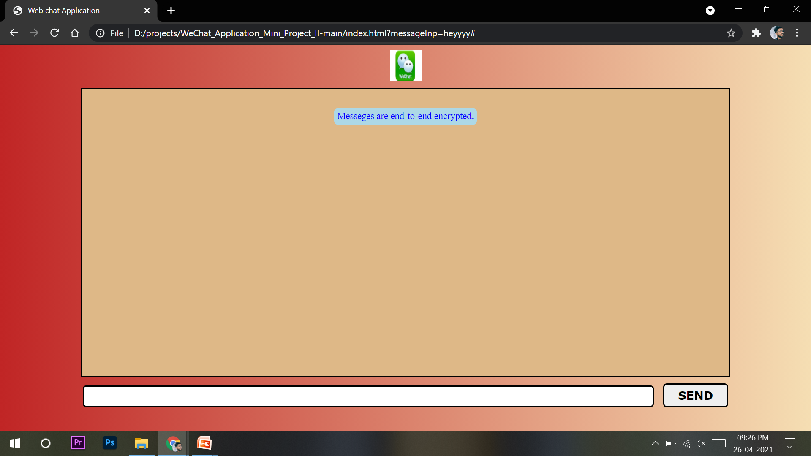
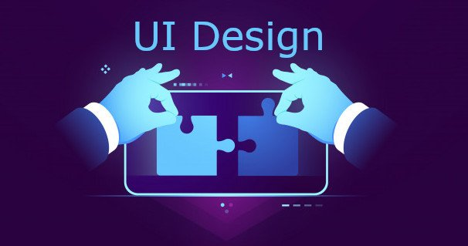

Slide 11

THANK YOU

